Slide 1
ADS Final Project
Does Money Make People Happy?
Team members: Junru Lu, Shijia Gu, Asilayi Bahetibieke, Jingtian Zhou
Instructor: Prof. Sobolevsky

Slide 2

Twitter with Location and Emojis
Twitter data provides information about citizens’ activities, emotions, and their mobility patterns with emojis and location informations.
Combining Twitter data with socio-economic data, we could investigate the relation between people’s emotions and their economic conditions.

Slide 3
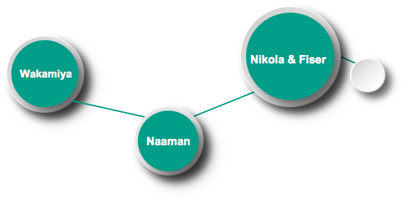
Literature Review
Provided a new way to rank city based on the intensity of residents’ online activities by analyzing the distribution of Twitter data
Made a first attempt at investigating the global distribution of emojis
Used more than 12 million Twitter data with tags to analyze spatial patterns of people’s daily activity
Notes:
Further, this paper also try to calculate the correlations between emojis and some WDI(World Development Indicators) like GDP per capita. It do tell us some things, but we want to know more detailedly!

Slide 4
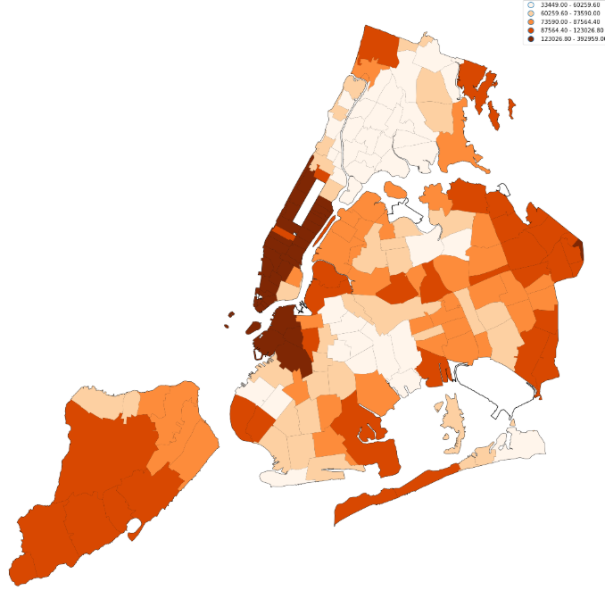
Data: Income
NYC 2016 Mean Household Income
Data acquisition: U.S. Census Bureau
Data cleaning: NaN filling and Drop Redundant Data
Data mining: geo-visualization, correlation analysis and regression
The mean household income based on NYC zips for Fiscal Year 2016
Notes:
The Mean Household Income Data in NYC is from U.S. Census Bureau, 2012 - 2016 5-Year American Community Survey. Firstly we groupby the data by zipcode. Then we drop redundant columns and keep Zipcode column and the Mean Household Income column. Finally, we find that there are some NAN values in data. So we clean up data by dropping these NAN values. Figure 6 shows Downtown Manhattan and downtown Brooklyn have the highest mean household income

Slide 5
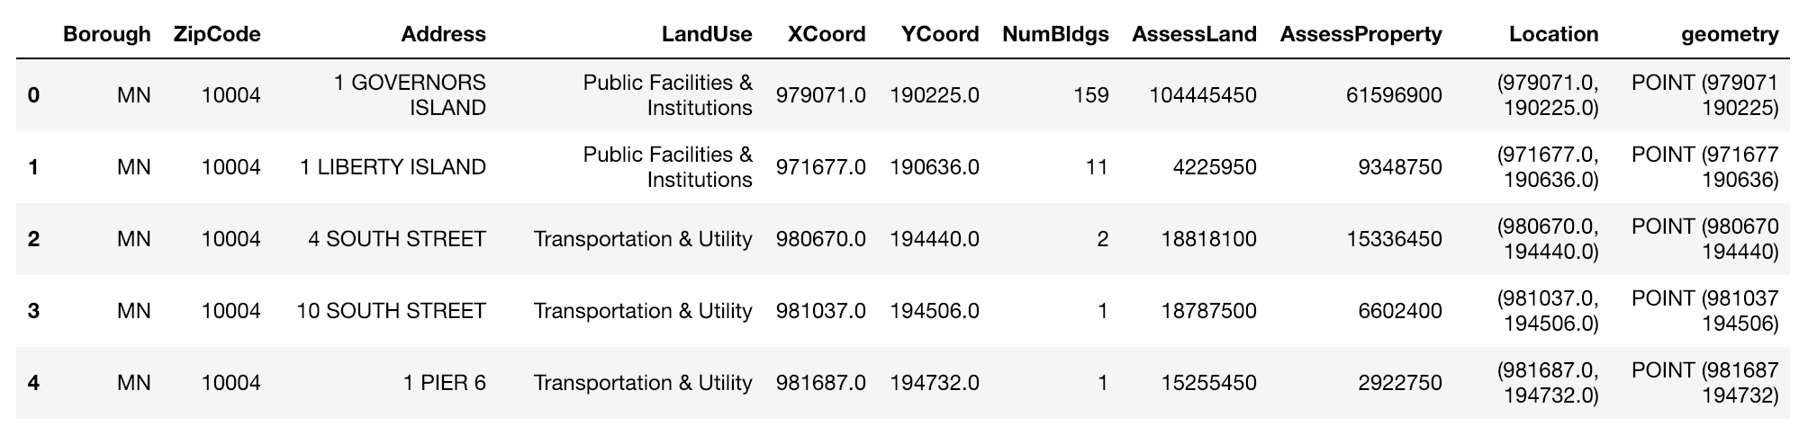
Data: PLUTO
NYC PLUTO data by zips

Slide 6
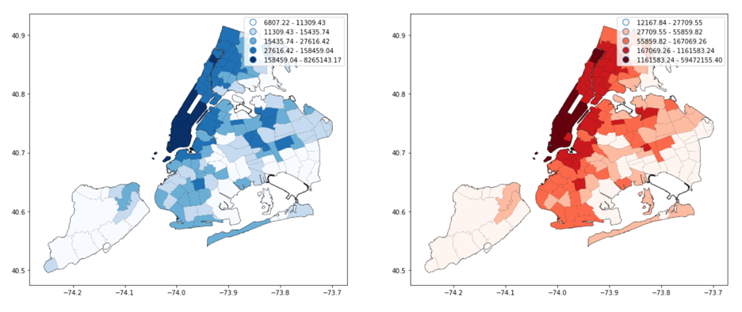
Data: PLUTO
The mean of the assessment of land and its property in NYC zips for Fiscal year 2018.

Slide 7
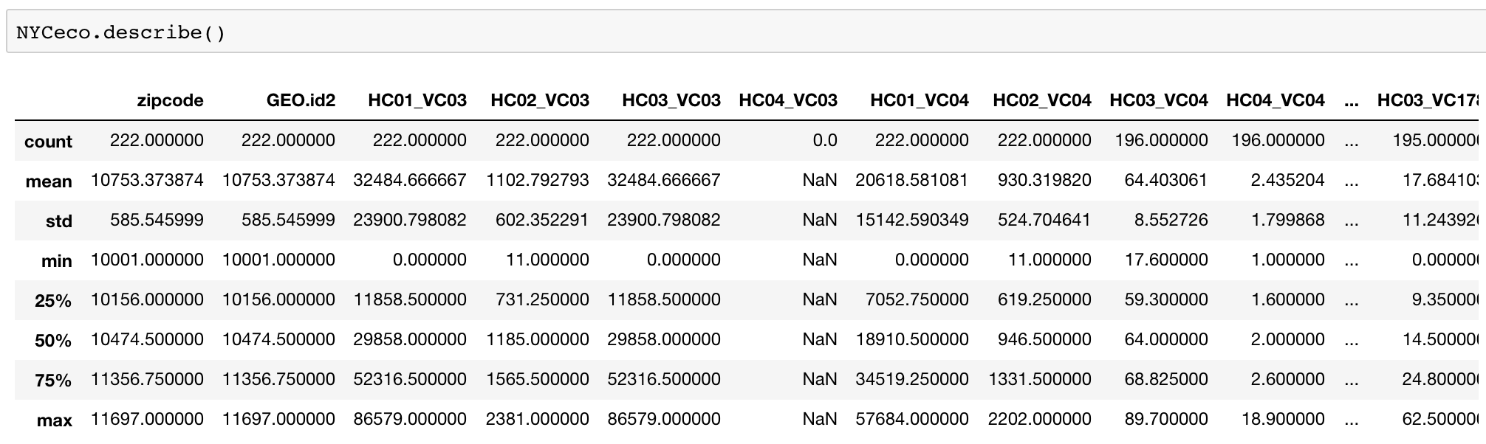
Data: ACS
Description of 2013-2017 ACS 5-year estimate data of NYC
Notes:
1.Select NYC parts; 2.Remove NaNs; 3.PCA for dimensionality reduction

Slide 8
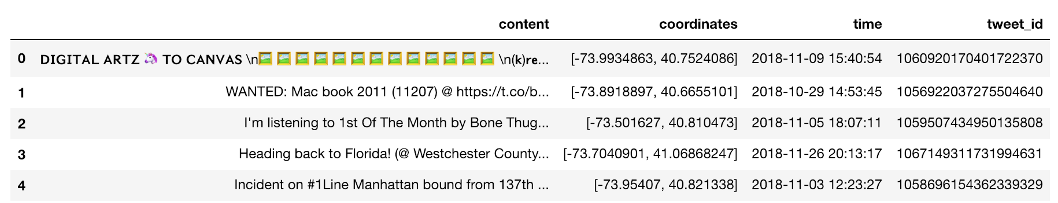
Data: emotion
424,000 Geo-tagged tweets in NYC from 2018-10-24 to 2018-11-25

Slide 9
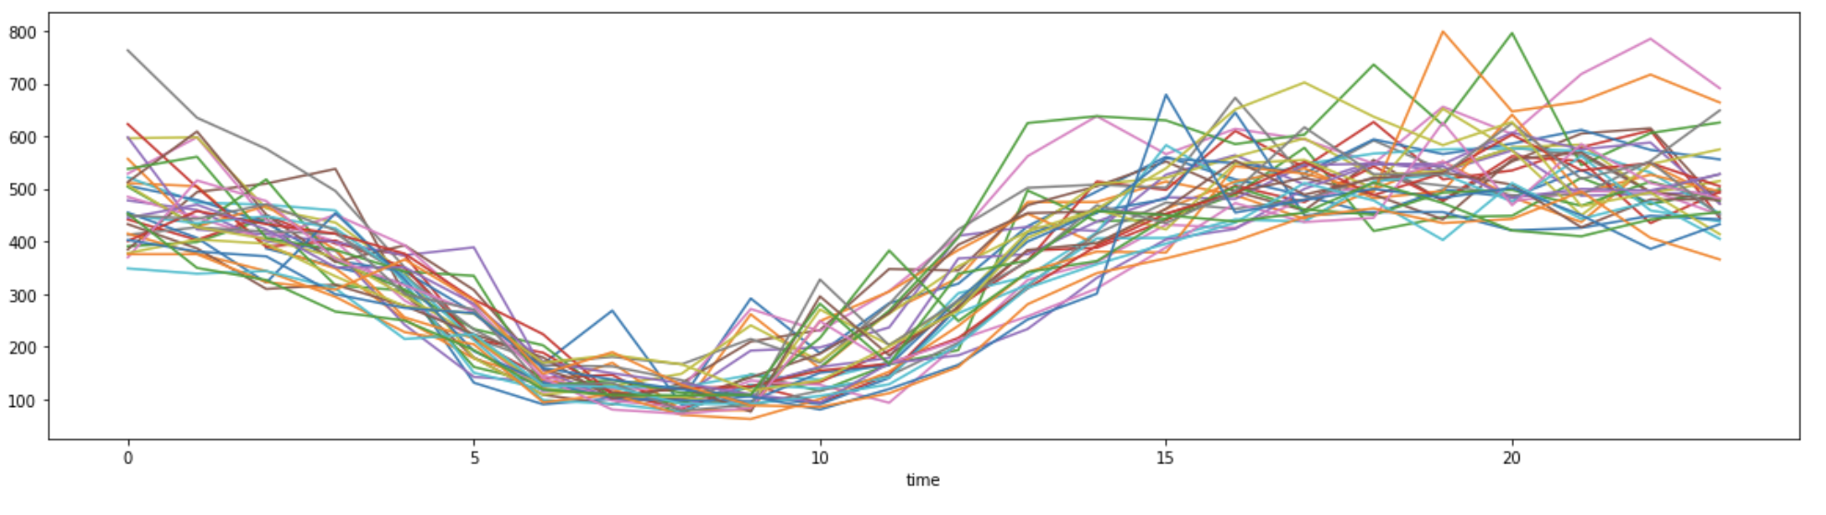
Data: emotion
Notes:
Through the time series of tweets in every zip areas, we can find that people’s tweeting has an obvious circadian pattern. So, we select out the tweets possibly posted in a residential area by limiting their posting time.

Slide 10
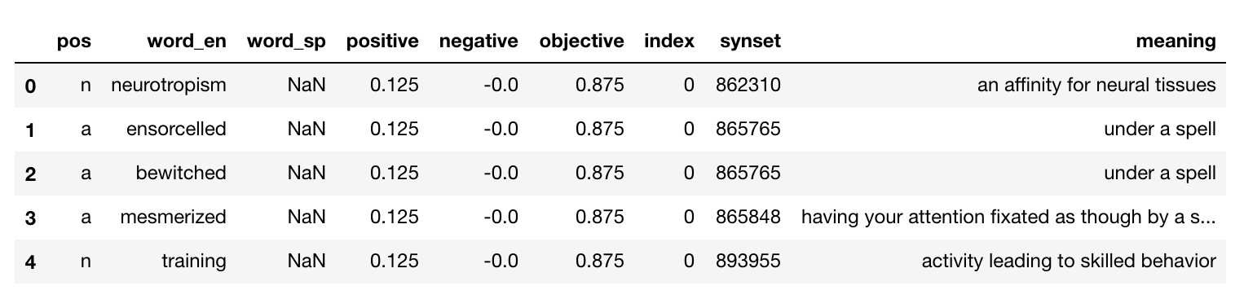
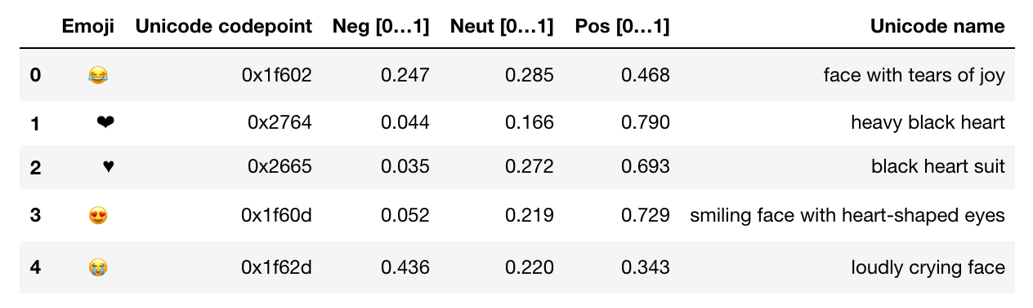
Data: emotion
SentiWordNet
Emoji Sentiment Rankings
Notes:
①After having the appropriate tweet data, we draw on the method of sentiment analysis in natural language processing, which uses the sentiment dictionaries based on large-scale statistics to quantify the positive, negative and neutral sentiment scores of each tweet.
②We looked for two sets of sentiment dictionaries, one is SentiWordNet [7] from NLTK package for English words and the other is Emoji Sentiment Ranking for emojis [8]. The constructions of them are shown in Figure 3.

Slide 11
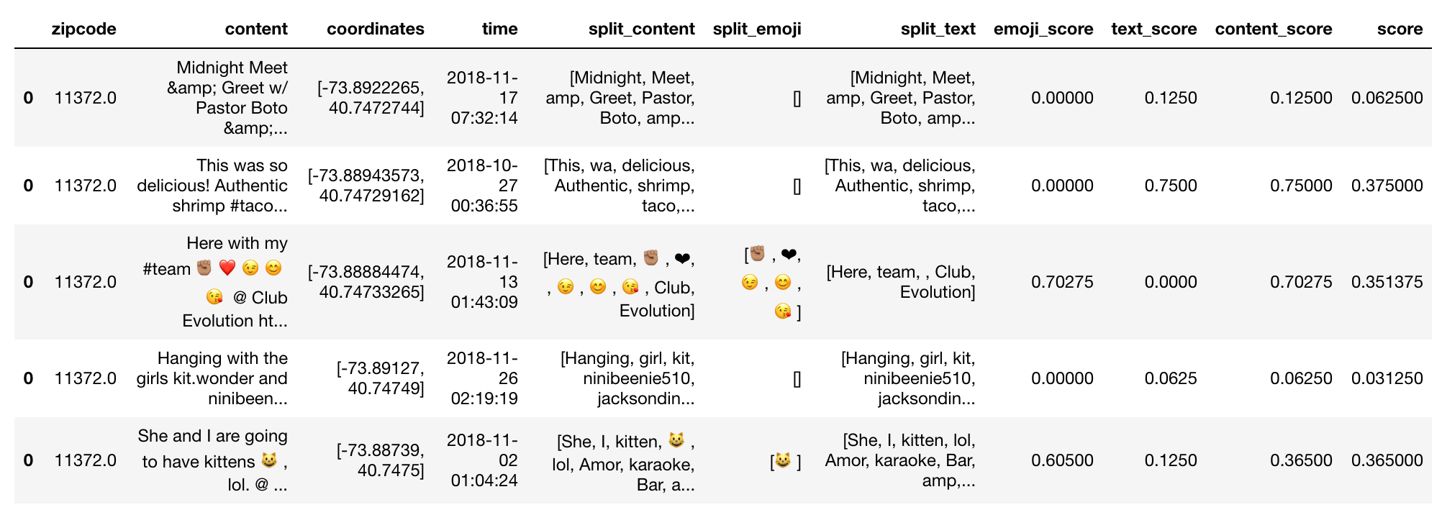
Data: emotion
Notes:
The next thing to do is segmentation. We remove all URLs, punctuation, and stop words in each tweet, then split the tweets into tokens and lemmatize all tokens. Finally, we use the average of the positive scores of each token to get the scores of the sentence. Among four scores, emoji score, text score and content score are calculated by using split emoji, split text and split content, respectively. And score equals 50% emoji score plus 50% text score. The reason that we give emoji and text equal weights is because in some cases that people use diverse languages or social-media-kind way of expression on twitter.

Slide 12
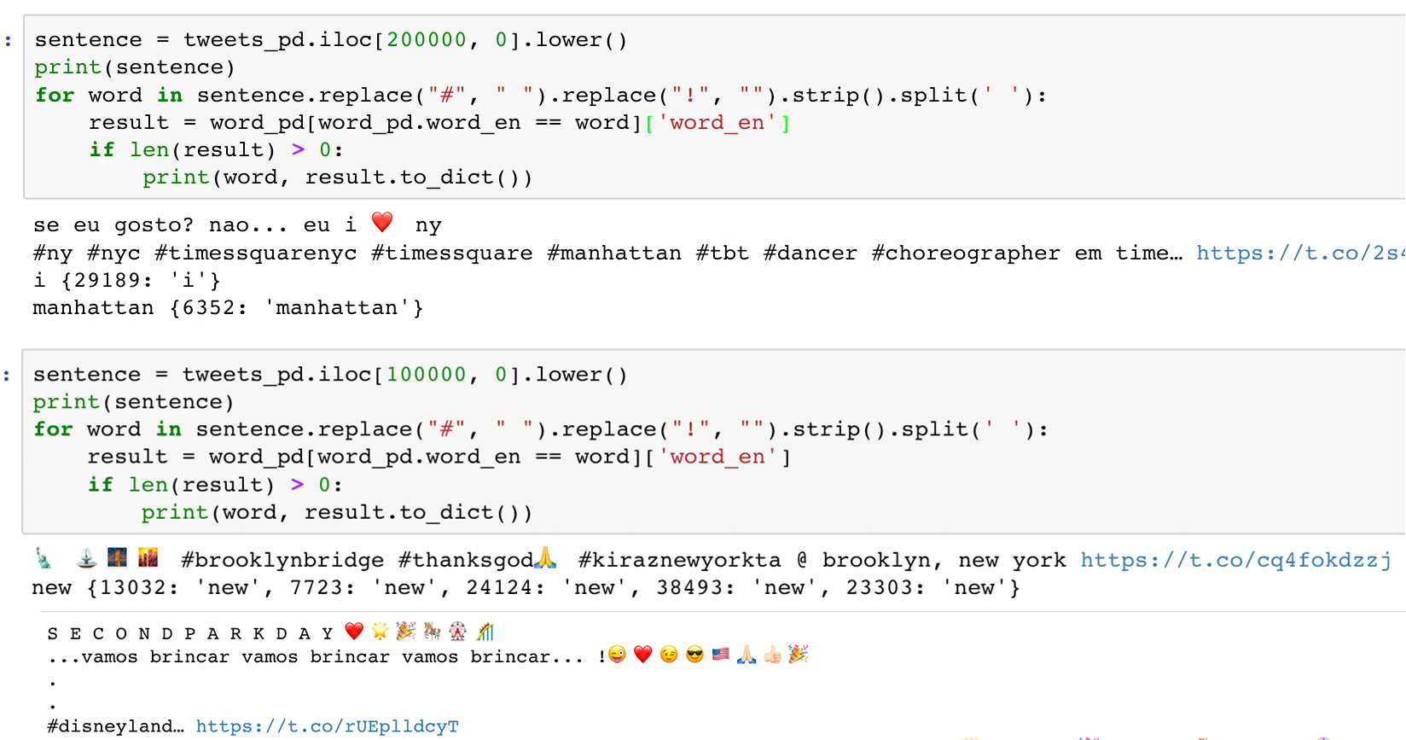
Notes:
Figure 5 shows some cases. Finally, we filter out 70,000 rows with a non-zero score as the final available data.

Slide 13
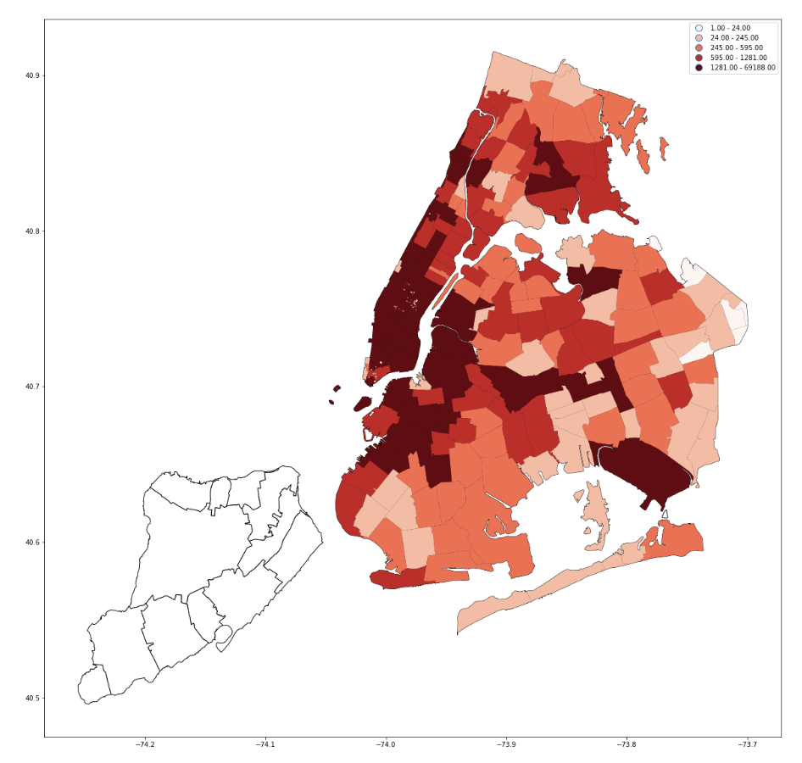
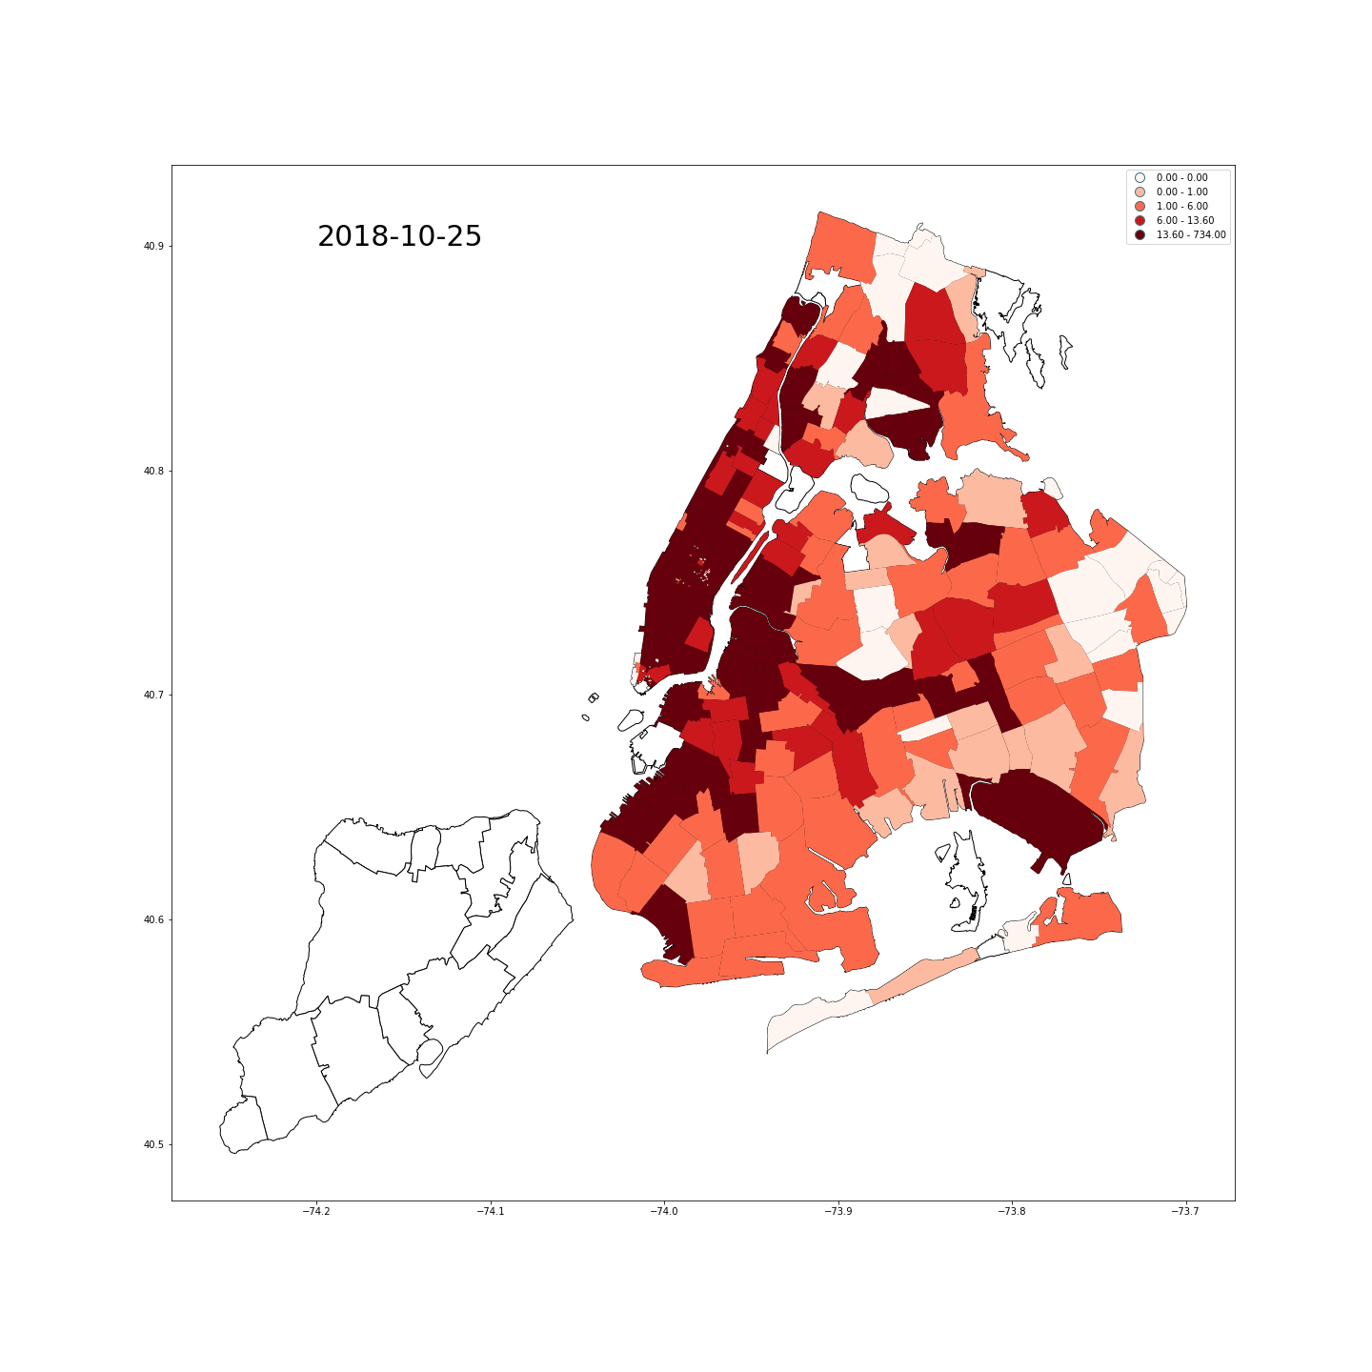
Time-spatial map for the posting number of geo-tagged tweets from 2018-10-24 to 2018-11-25
Notes:
We briefly analyzed the posting number of geo-tagged tweets and the sentiment scores of these tweets from a time-spatial view. Figure 8 shows several time-spatial maps. The left plotting shows people in NYC are more likely to post geo-tagged tweets in mid & low Manhattan, downtown Brooklyn and JFK (Maybe to memory that they are arriving or leaving the city).

Slide 14
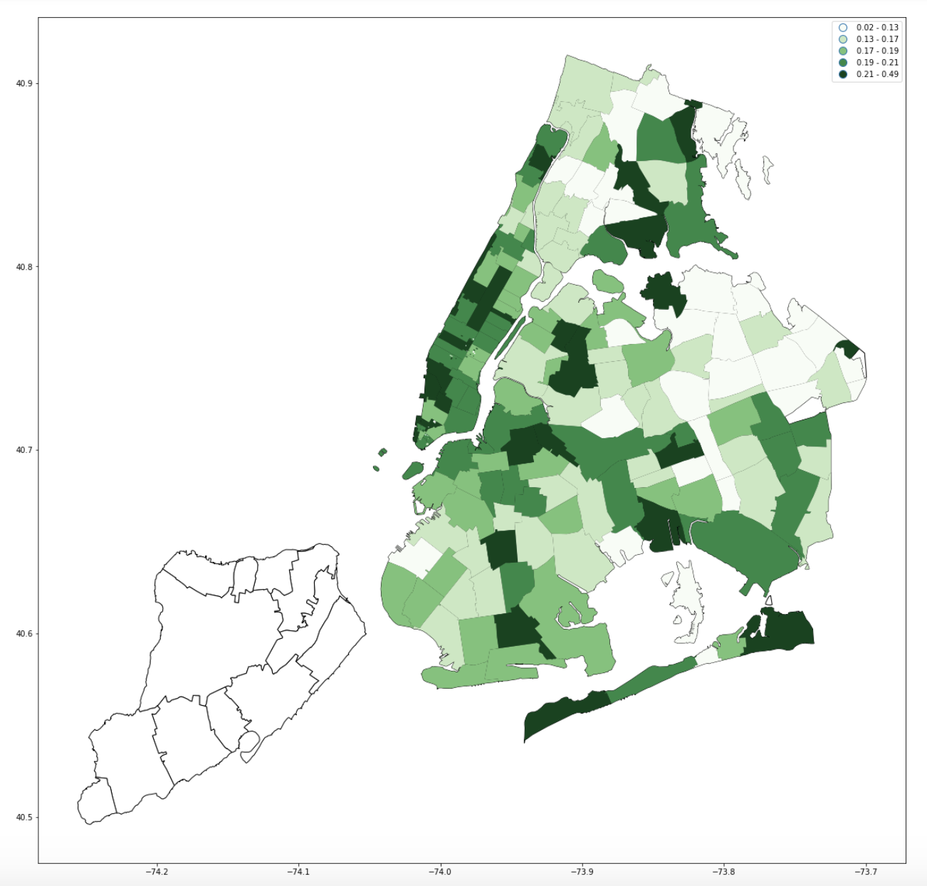
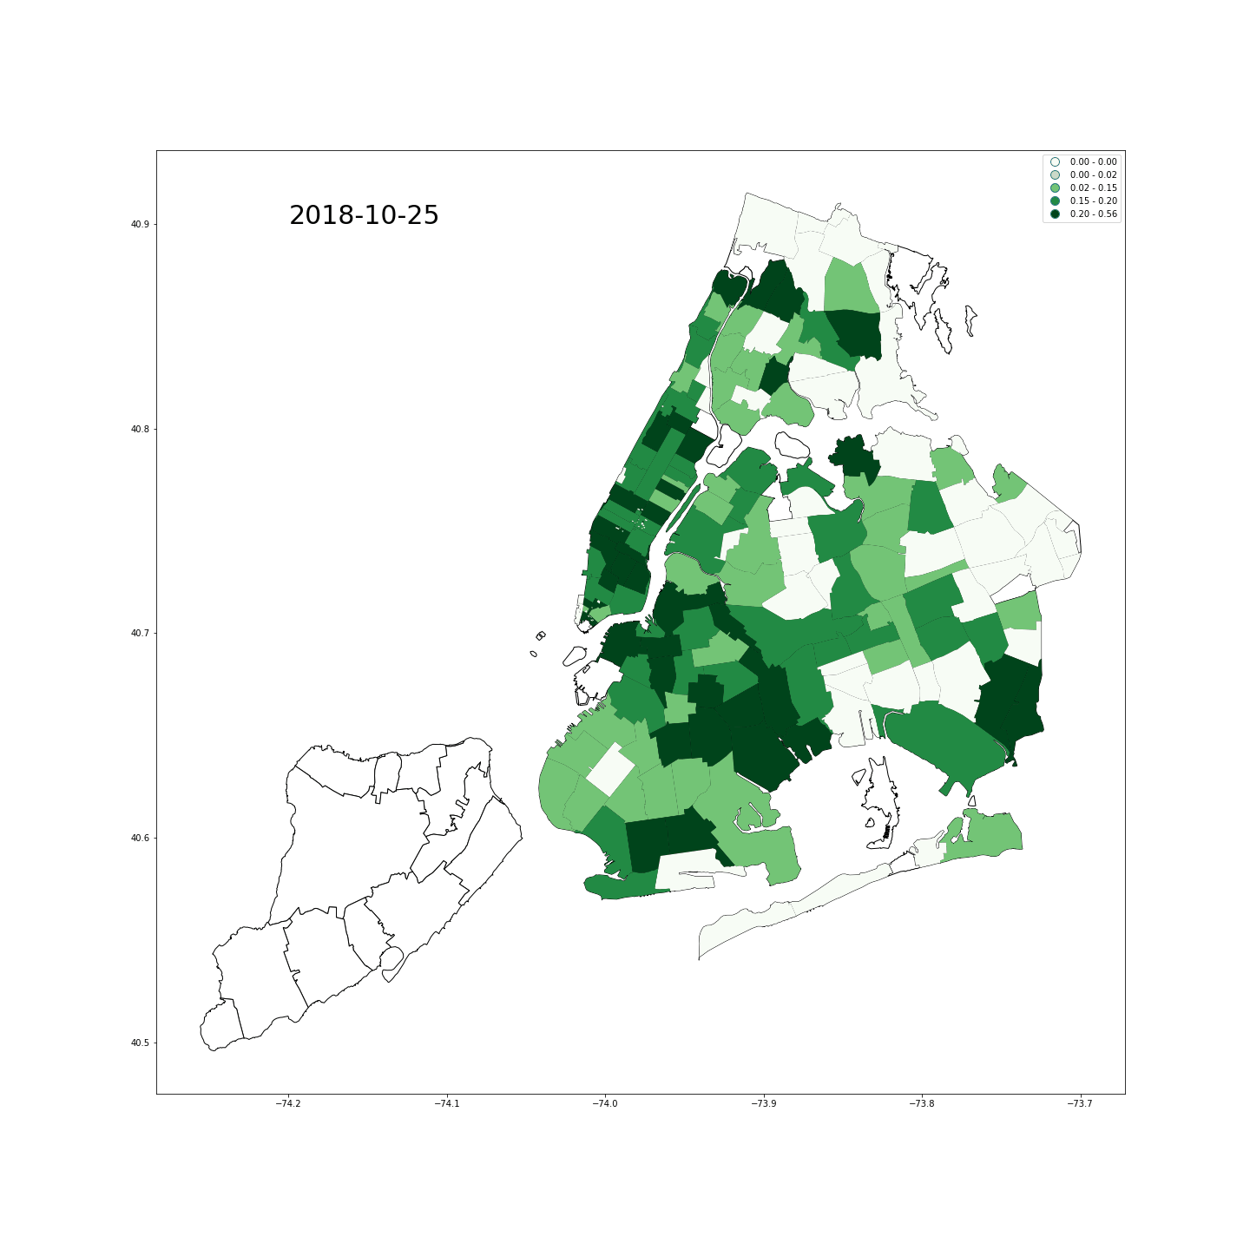
Time-spatial map for the positive emotion scores of geo-tagged tweets from 2018-10-24 to 2018-11-25
Notes:
Plot of positive emotion scores, more random

Slide 15
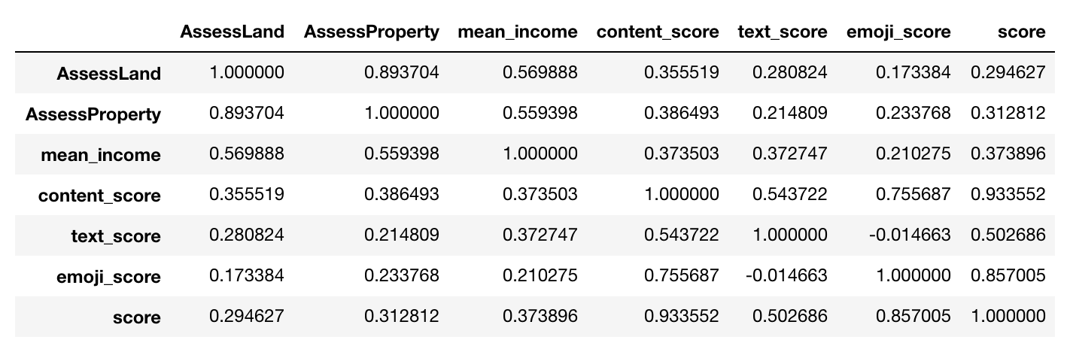
Analytics: correlation
Notes:
the correlations between the first group of socio-economic features and four emotion scores show that these features are around 20%~30% positive correlated with our emotion.

Slide 16
Analytics: regression
 | Group 1 (Income, land assessment and property assessment) | Group 2 (2013-2017 ACS 5-year estimate)
Ridge / Train | 0.1573 | 0.1650
Ridge / Test | 0.1241 | 0.0924
Lasso / Train | 0.1287 | 0.1161
Lasso / Test | 0.1007 | 0.0591
Notes:
We use the Ridge and Lasso models for regression. Our target value is the score column. The entire data set is divided into training and testing sets by 9:1. Table 1 shows the evaluation on both models with optimal α. The model consisting of income, house price and land price has about 10~15% explanatory ability.

Slide 17
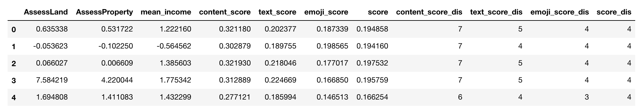
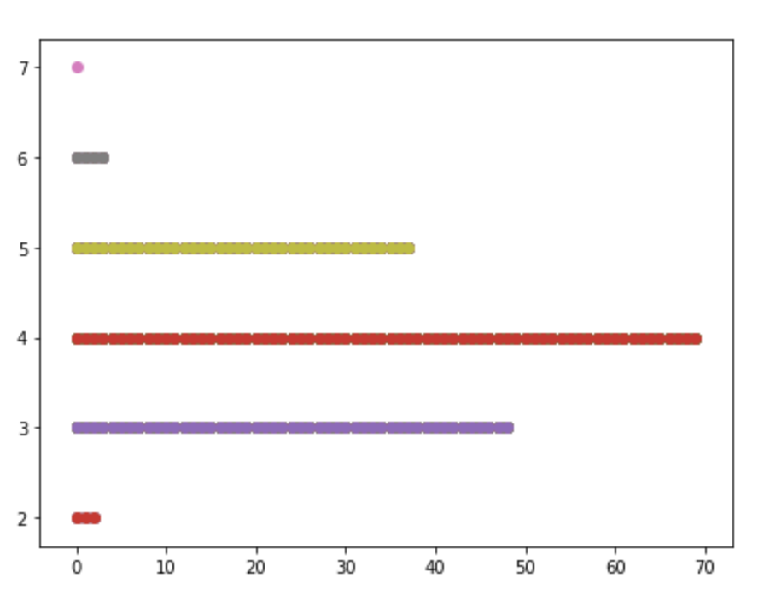
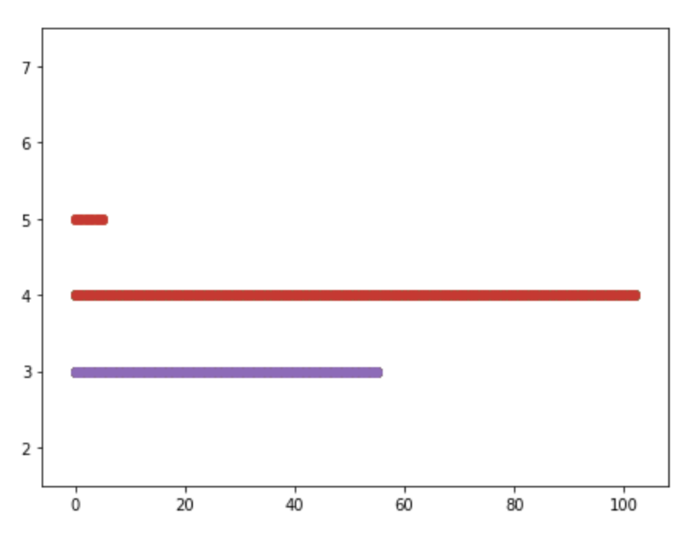
Analytics: classification
 | Group 1 (Income, land assessment and property assessment) | Group 2 (2013-2017 ACS 5-year estimate)
Train | 0.4797 | 0.5563
Test | 0.3529 | 0.1875
Notes:
Since the prediction results on regression models are poor, we decide to discretize the target score. The result of discretization can be understood as that we divide the emotion score into multiple degrees from weak to strong. The processed data are shown in Figure 10. We use the Logistic models. Table 2 shows the evaluation with the param C=10000.

Slide 18
Conclusion
Wealth and happiness are positively related, but the relationship is not decisive.
Socio-economic data can help generally judge the intensity of a person's positive emotion.
Happiness is not dependent on wealth!
Notes:
Based on the regression result, wealth and happiness are positively related, but the relationship is not decisive. However, socio-economic data can help generally judge the intensity of a person's positive emotion according to the classification accuracy (0.4797).
We can tell that happiness is not dependent on wealth! There are many determinants, which reveal more significance than money, such as sense of safety, love and belonging, esteem and self-actualization that lead people towards happiness. Money has 15% impact on happiness, the rest 85% depends on ourselves.

Slide 19
Q & A
(Please refer to our github page for technical details: https://github.com/LuJunru/ADS2018_Final_Project)

Slide 20
Appendix: shortage
Age limitation and user diversity on twitter users
Time-consuming work on further filter reliable tweets
Emoji dictionary is limited
Comparability between discrete labels is neglected

